Slide 1
Welcome to training on computer security at Reminger using multifactor authentication. In this session you will learn what multifactor authentication is, why we use it, and how it works in our environment.

Slide 2
Multifactor authentication is sometimes called by its initials “MFA.” It is a tech security method that is stronger than a password because it requires the user to provide more than one means of identification. Users provide something they know, such as a user name and password, and use something they possess, such as a cell phone, to receive a text message with a single-use numeric code.
Some multifactor authentication programs also require users to provide something that is uniquely theirs, such as a fingerprint. You may be choosing to use that form of authentication to unlock your cell phone. Reminger does not require that type of authentication.

Slide 3
Reminger uses MFA on our major systems because it is more secure that relying on a password alone. Microsoft Office, NetDocuments, and Adobe Acrobat all require 2-step authentication with both your network login as well as a security code sent to your cell phone.
You will need to complete this process when you first set up your Reminger computer access. You will need to repeat the process about every 6 months when you update your password. If you reset your password more often, you will need to repeat this process more frequently.

Slide 4
The following slides will walk you through the process of setting up multifactor authentication on your Reminger systems. Be sure to complete the steps in the order presented. Each step is presented in detail with images to guide you along the way.
The process should take you less than 15 minutes to complete.
If you have questions or need assistance, call the Helpdesk at extension 5555 or send an email to helpdesk@reminger.com.
Thanks for your time and attention.

Slide 5
To begin the Multi Factor Authentication process, you will need to (do X).

Slide 6
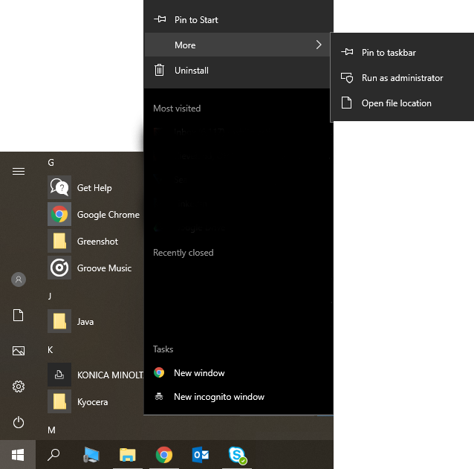
Setting up MFA: Step One
The first step in setting up multifactor authentication is to open Google Chrome. That will initiate creating a connection between your Reminger network login and your cell phone.
Google Chrome is the default browser used at Reminger. You might was to pin it to your Start Menu and Task Bar to make it more convenient to open. To pin Chrome, click on the Start menu, scroll down to Google Chrome and right click, choose More and then “Pin to taskbar.” You can also pin Chrome to the Start menu.
Now open Chrome.

